Slide 2
Unit 6: Pointers (6hrs)
Introduction
Pointer operators
Pointer arithmetic
Returning multiple values from functions using pointers
Pointers and Arrays
Double indirection
Dynamic memory allocation

Slide 3
7.10 Dynamic Memory Allocation
Arrays can be used for data storage, but they are fixed in size.
The programmer must know the size of the array or data in advance while writing the program.
But it is not possible to know the size of required memory at the time of writing the source code.
So to overcome this limitation, we use DMA technique.
DMA is the process of allocating and freeing memory in a program at runtime.
The DMA process reserves the memory required by the program and allows the program to utilize the memory.
If the allocated memory is no more in use, it returns the allocated memory to the system.
The deallocated memory now is free and any other program can use it.

Slide 4
There are four different library functions in C for memory management which are defined within header file stdlib.h and alloc.h
S.No | Functions | Purpose
1. | malloc() | Allocates required size of bytes and returns a pointer to the first byte of the allocated space to the program.
2. | calloc() | Allocates space for an array of elements and then sets all bytes to zero.
3. | realloc() | Modifies the size of previously allocated space.
4. | free() | Frees previously allocated space.

Slide 5
i) malloc ()
It allocates requested size of bytes and returns a pointer to the first byte of the allocated space.
It creates a single block of memory.
Syntax:
Pointer variable = (datatype *) malloc (sizeof block);
Eg:
x = (int *) malloc (100 *sizeof (int));
Here, sizeof (int) gives 2.
Thus, memory space of 100*2 bytes is reserved. And pointer x points to the first address of the allocated memory.
Also it can be written as:
x = (int *) malloc (200);

Slide 6
ii) calloc ()
It allocates multiple block of storage, each of the same size and then sets all bytes to zero.
Syntax:
Pointer variable = (datatype *) calloc( no of blocks, sizeof each block);
Eg:
x = (int *) calloc (5 ,sizeof (int));
Or
x = (int *) calloc ( 5, 2 );
The above statements allocate contiguous memory space for 5 blocks each of size 2 bytes.

Slide 7
iii) realloc ()
It allows us to modify the memory size of previously allowed space, in case of excess or shortage of the allocated space.
Syntax: (if malloc() was used)
Pointer variable = (datatype *) realloc (pointer, new sizeof block);
Eg:
x = (int *) realloc (x,10);

Slide 8
iv) free ()
It is used to release the space when it is not required.
Syntax:
free (pointer variable);
Eg:
free( x);

Slide 9
7.11 Dynamic Array
An array created at compile time by specifying size in the source code has a fixed size and cannot be modified at run time.
The process of allocating memory at compile time is known as static memory allocation and the arrays that receives static memory allocation are called static arrays.
This approach works fine as long as we know exactly what our data requirements are.
Suppose we don't know what are our data requirements in that case we can use dynamic arrays.
In C, it is possible to allocate memory to arrays at run time.
This feature is known as dynamic memory allocation and the arrays created at run time are called dynamic arrays.
Dynamic arrays are created using pointer variables and memory management functions malloc, calloc and realloc.

Slide 10
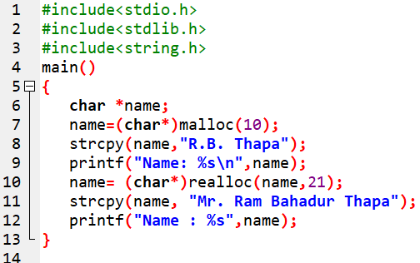

WAP to illustrate the use of malloc() and realloc().

Slide 11
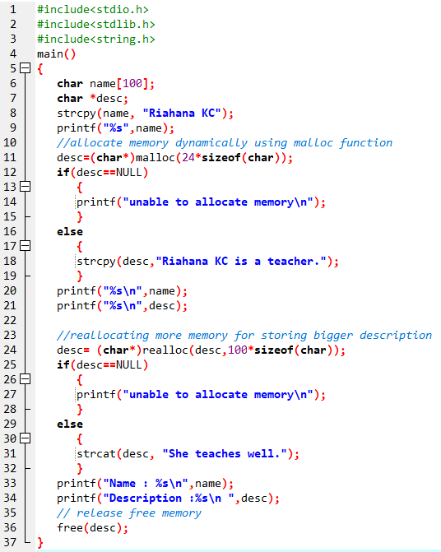
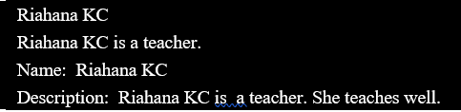
WAP to resize the string “Riahana KC is a teacher.” with new string “Riahana KC is a teacher. She teaches well.”

Slide 12
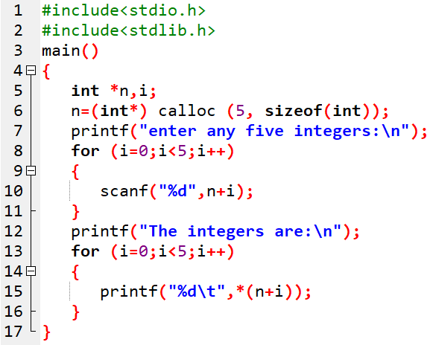
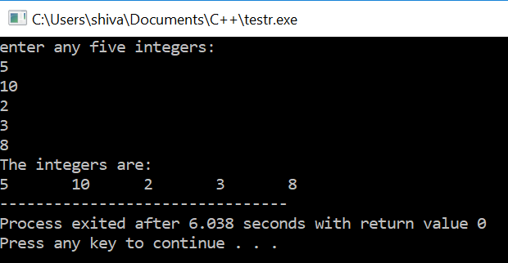
WAP using pointer array to enter any five integers and display them. Use the calloc() function to allocate memory.

Slide 13
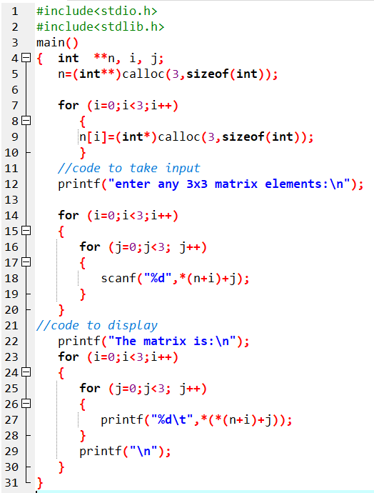
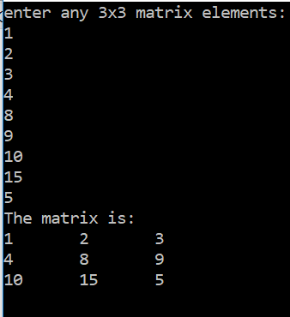
WAP using pointer array to enter a 3*3 matrix and display them. Also make use of calloc() function for DMA.

Slide 14
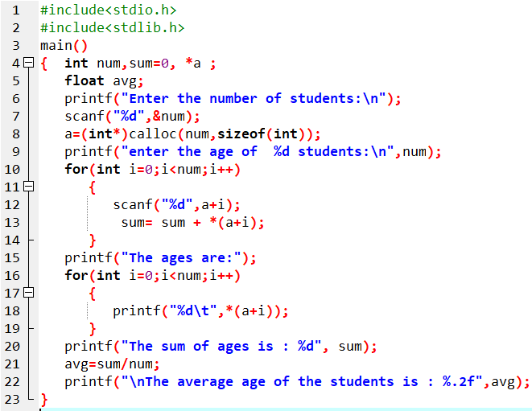
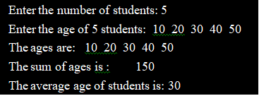
WAP to read n number of students from user and the read the age of each student. Display the entered ages and their average value. Use pointer instead of conventional array to represent ages of different students.

Slide 15
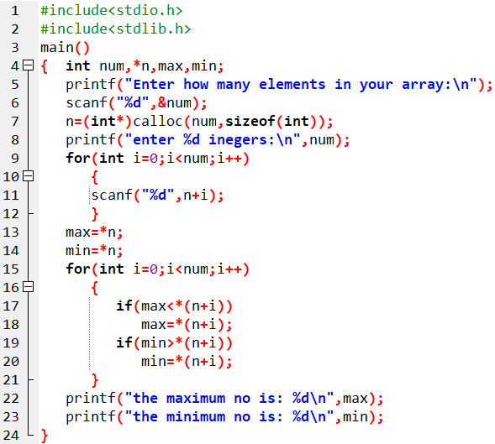

WAP to read a list of integers using DMA and display the largest and smallest elements among them.

Slide 16
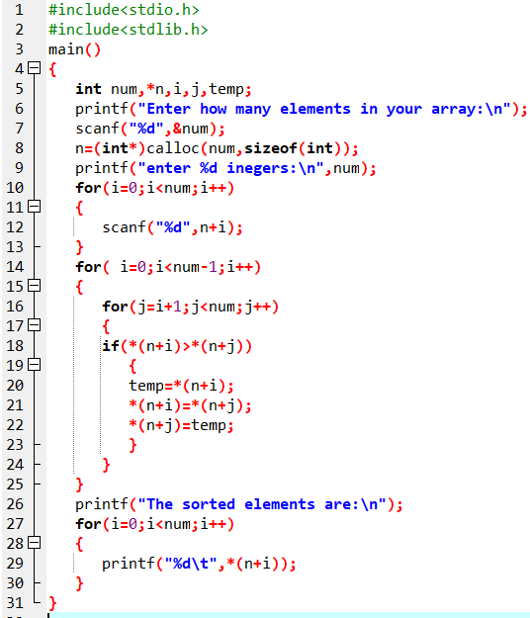

WAP to read n numbers in an array and sort the elements in ascending order. Use dynamic memory allocation.

Slide 17
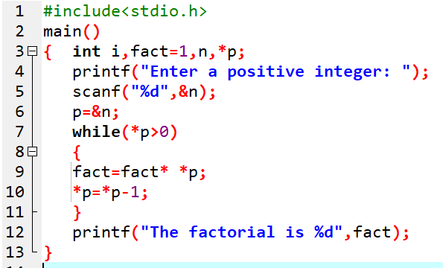

WAP to enter positive integer and find its factorial using pointer.

Slide 18
Assignment:
WAP using pointers to read an array of integers and print its elements in reverse order.
WAP using pointers to accept N integers in an array using DMA and sort them in descending order.
WAP using pointer to accept the elements of 3x3 matrix and display the sum of all the elements.
WAP using pointers to accept the marks of n students using DMA and display the top five marks.

Slide 19
End of Lecture 14

Slide 20
Structure and Union

